Slide 1

光の忍者
NINJA! Shine
TAP THE SCREEN TO START
©2017 YIPIKAYE! STUDIOS. ALL RIGHTS RESERVED.

Slide 2
光の忍者
NINJA! Shine
STORY MODE
OPTIONS

Slide 3
光の忍者
NINJA! Shine
NEW GAME
CONTINUE

Slide 4
光の忍者
NINJA! Shine
NEW GAME
CONTINUE

Slide 5
光の忍者
NINJA! Shine
STORY MODE
OPTIONS

Slide 6
光の忍者
NINJA! Shine
STORY MODE
OPTIONS

Slide 7
光の忍者
DIFFICULTY
VOLUME
SCREEN BRIGHTNESS
MANUAL

Slide 8
DIFFICULTY
光の忍者
EASY
NORMAL
HARD
BACK

Slide 9
DIFFICULTY
光の忍者
EASY
NORMAL
HARD
BACK

Slide 10
DIFFICULTY
光の忍者
EASY
NORMAL
HARD
BACK

Slide 11
DIFFICULTY
光の忍者
EASY
NORMAL
HARD
BACK

Slide 12
光の忍者
DIFFICULTY
VOLUME
SCREEN BRIGHTNESS
MANUAL

Slide 13
光の忍者
DIFFICULTY
VOLUME
SCREEN BRIGHTNESS
MANUAL

Slide 14
光の忍者
DIFFICULTY
VOLUME
SCREEN BRIGHTNESS
MANUAL

Slide 15

VOLUME
光の忍者
MUSIC
100%
SFX
100%
BACK

Slide 16
VOLUME
光の忍者
MUSIC
100%
SFX
100%
BACK

Slide 17
光の忍者
DIFFICULTY
VOLUME
SCREEN BRIGHTNESS
MANUAL

Slide 18
光の忍者
DIFFICULTY
VOLUME
SCREEN BRIGHTNESS
MANUAL

Slide 19
SCREEN BRIGHTNESS
光の忍者
100%
BACK

Slide 20
SCREEN BRIGHTNESS
光の忍者
100%
BACK

Slide 21
光の忍者
DIFFICULTY
VOLUME
SCREEN BRIGHTNESS
MANUAL

Slide 22
光の忍者
DIFFICULTY
VOLUME
SCREEN BRIGHTNESS
MANUAL

Slide 23

MANUAL
光の忍者

Slide 24
CAPTURED
CONTINUE?

Slide 25
GAME OVER

Slide 27
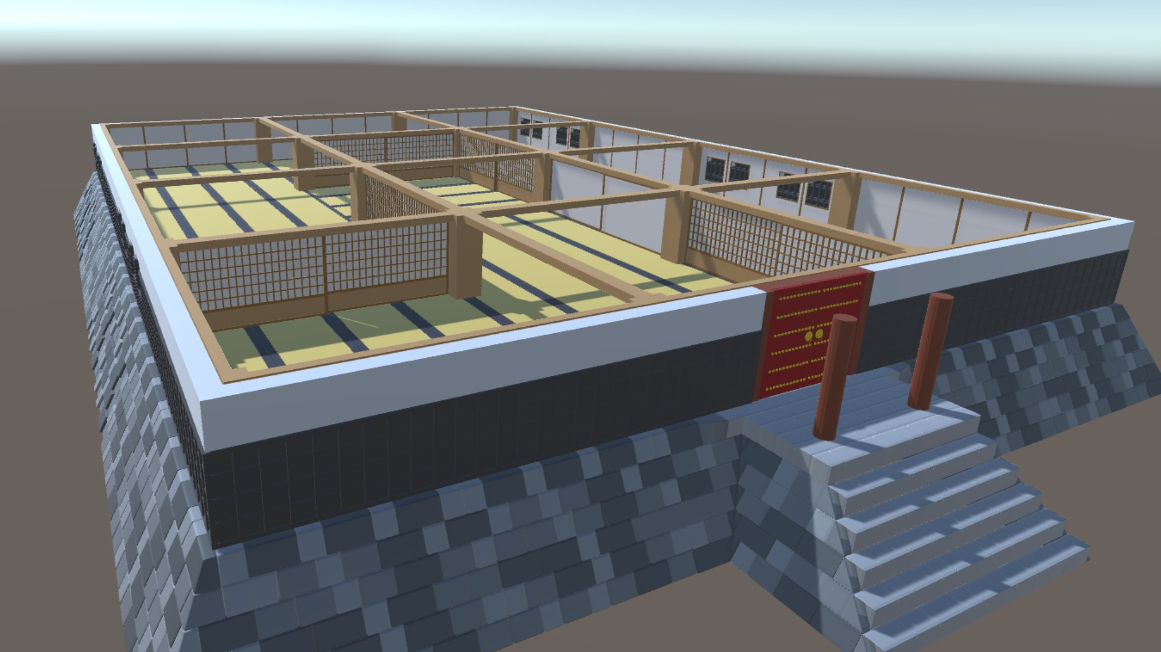
PAUSED
RESUME
RESTART
OPTIONS
EXIT

Slide 28
PAUSED
RESUME
RESTART
OPTIONS
EXIT

Slide 29
PAUSED
RESUME
RESTART
OPTIONS
EXIT

Slide 30
PAUSED
RESUME
RESTART
OPTIONS
EXIT

